Slide 1
Telecom Customer Churn Analysis Report
Predicting churn and identifying strategies for user retention
Objective: Predict churn and understand key factors influencing customer loss.
Tools Used: Power BI, Python (for ML), SQL (for aggregation).
Dataset: 7,000+ customers with features like Contract, InternetService, PaymentMethod, etc.

Slide 2
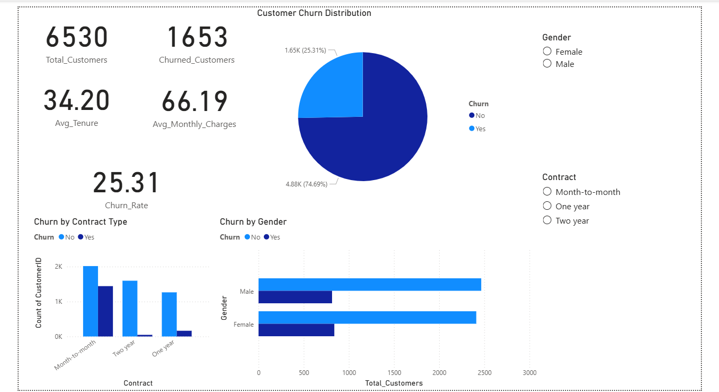
Churn Insights

Slide 3
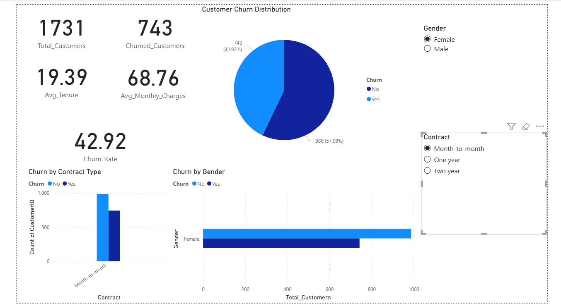
Customer Churn Analysis – Female (Month-to-Month Contract)

Slide 4
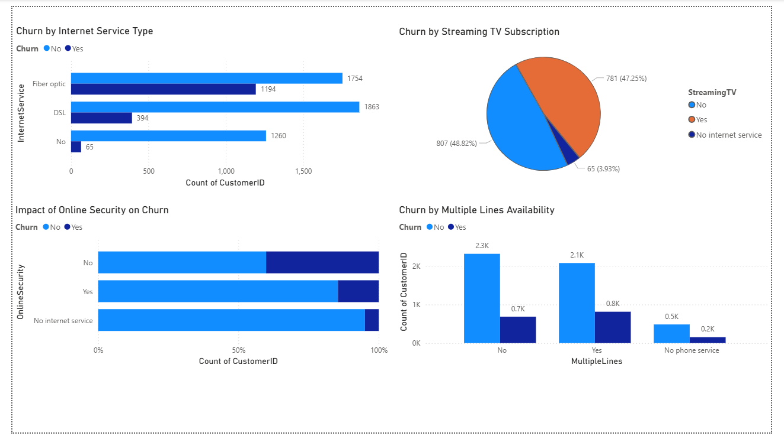
Impact of Service Features on Customer Churn

Slide 5
Final Recommendations
Focus on High-Risk Segments
Improve Service Experience
Increase Engagement via Add-ons
Personalised Communication
Data-Driven Monitoring
By implementing these actions, the company can reduce churn by 10–15%, increase customer lifetime value, and improve retention through proactive engagement.

Slide 6
Conclusion
By understanding the drivers of churn and focusing on customer experience, the telecom company can reduce churn by up to 10–15% within the next quarter.

